Slide 1
Media Report
The PROJECT „Time to work“
Press conference and Online forum
World Arthritis Day 2021.
ORS

Slide 2
World Arthritis Day 2021.
The Association of Patients with Rheumatic Diseases of the Republic of Serbia (ORS) organized a press conference regarding the realization of the project "Time to work" . The conference was held on October 12th 2021, in the Belgrade Press Center of the Association of Journalists of Serbia, with a good attendance of representatives of written and digital media.
Topic of conference was joint efforts to improve the employment of persons with disabilities (PWDs) and/or persons with rheumatic and bone and joint diseases (RMD) in the Republic of Serbia.
Full recording of press conference is avaliable on Press Center Youtube Channel:
Svetski dan borbe protiv artritisa – YouTube
The Association of Patients with Rheumatic Diseases of the Republic of Serbia (ORS) organized a interactive online forum regarding World Arthritis Day . The forum was held on October 12th 2021. (Attendance: Approx 50 attendees participated on Forum by Zoom platform.
Full recording of Forum is avaliable on ORS website: https://youtu.be/POBikONxzAE

Slide 3
Media appearances
22 journalists participated on WAD press conference ( Politika, Danas, Kurir, Alo, Večernje Novosti, Srpski telegraf, Telegraf.rs, Espreso.rs, Mondo, Radio Beograd1, Studio B, Tanjug, Tanjug TV, Kurir TV, TV Pink, TV Republika Srpska, Beta, TV Euronews...)
Total of registered published/broadcasted appearances: 38
TV - 12 appearances : RTS1, StudioB (2) TV Euronews, TV Republika Srpska, TV Pink Vesti (2), TV Kurir (2) TV K1, TV Belami, TV Vojvodina
Radio- 1 appearance : Radio Beograd 1
Media portals – 19 appearances - espreso.rs, kurir.rs, studiob.rs, tanjug.rs,beta.rs, belami.rs, rtv.rs, srbijadanas.rs, lepa i srećna.rs, mondo.rs danas.rs, politika.rs, republika.rs, telegraf.rs, informer.rs, novi magazin.rs, top vesti.rs, vesti.rs, naslovi.rs
Print editions – 4 : Politika, Danas, Alo, Dnevnik
Expecting 2 more apearances in Politika and Informer print editions

Slide 4
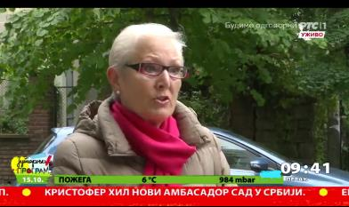
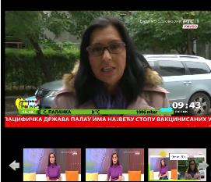
Appearance examples

Slide 5
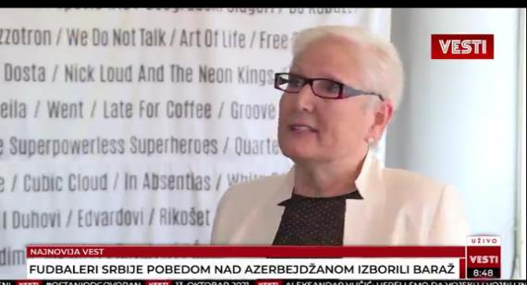
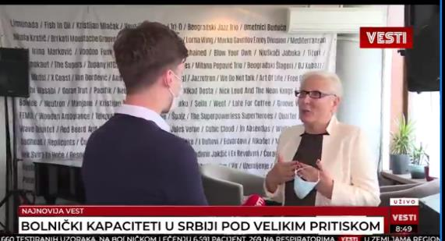
Appearance examples

Slide 6
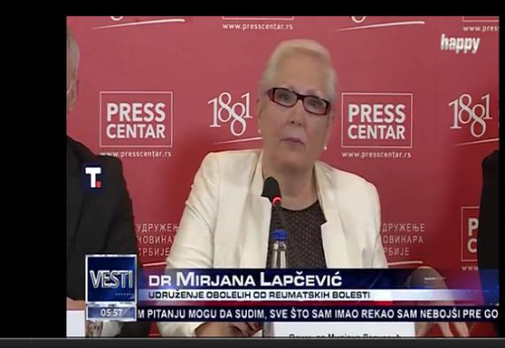
Appearance examples

Slide 7
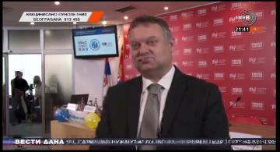
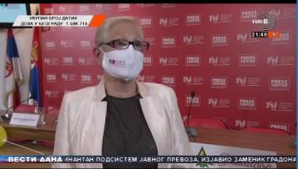
Appearance examples

Slide 8
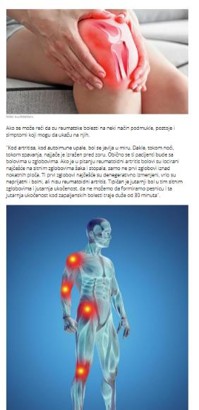
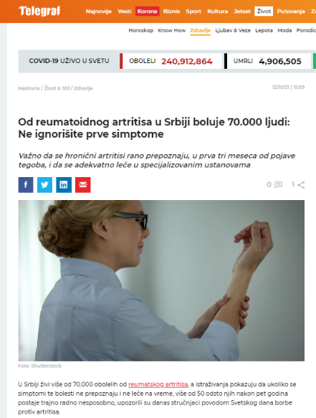
Appearance examples

Slide 9
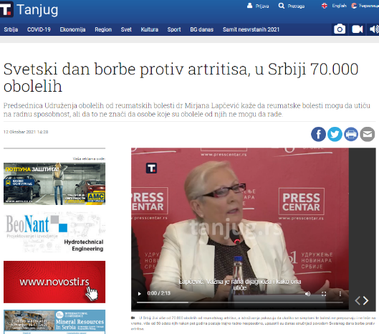
Appearance examples

Slide 10
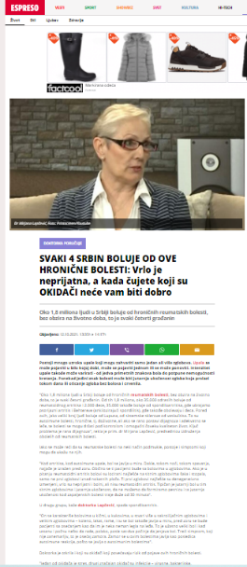
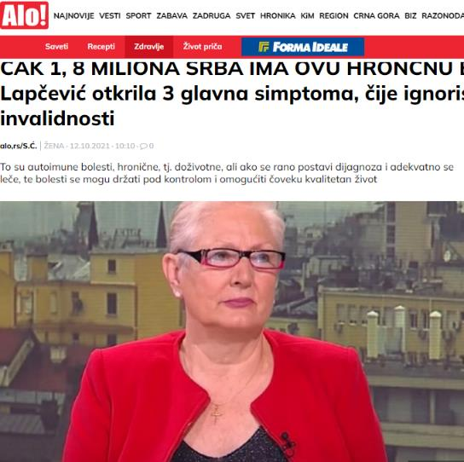
Appearance examples

Slide 11
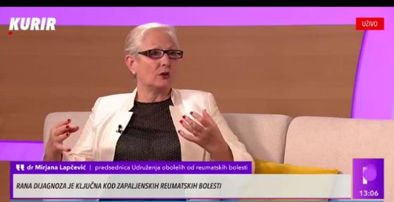
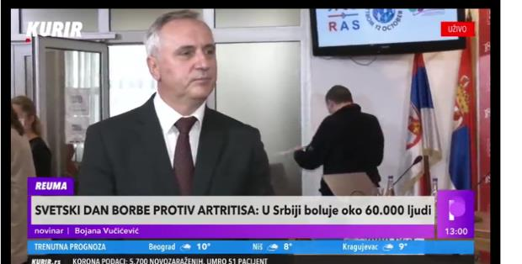
Appearance examples

Slide 12
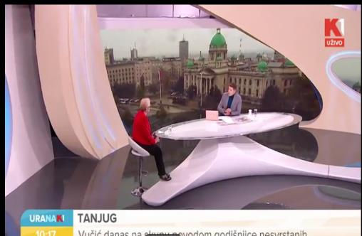
Appearance examples

